Slide 1


CMR TECHNICAL CAMPUS
UGC(Autonomous)
Kandlakoya,Medchal Road,Hyd-501 401 Department of Computer Science Engineering
Mini Project On
DETECTION OF STROKE DISEASE USING MACHINE LEARNING ALGORITHMS
BATCH NO : 20
Project Guide: BATCH MEMBERS:
M.MADHUSUDHAN 207R1A0571 CH. Ajay Kumar
Associate Professor 207R1A05B3 S. SRIKANT
Project Coordinator:
J.Narasimharao
Associate Professor, C

Slide 2
CCCONTENTS:
INTRODUCTION
ABSTRACT
EXISTING SYSTEM
PROPOSED SYSTEM
SYSTEM REQUIREMENTS
NOVELTY OF PROJECT
ARCHITECTURE
MODULES
UML DIAGRAMS
CONCLUSION.

Slide 3
ABSTRACT
. A stroke is a medical condition in which poor blood flow to the brain results in cell death. Several risk factors believe to be related to the cause of stroke has been found by inspecting the affected individuals. Using these risk factors, a number of works have been carried out for predicting and classifying stroke diseases
Most of the models are based on data mining and machine learning algorithms. In this work, we have used four machine learning algorithms to detect the type of stroke that can possibly occur or occurred form a person’s physical state and medical report data.

Slide 4
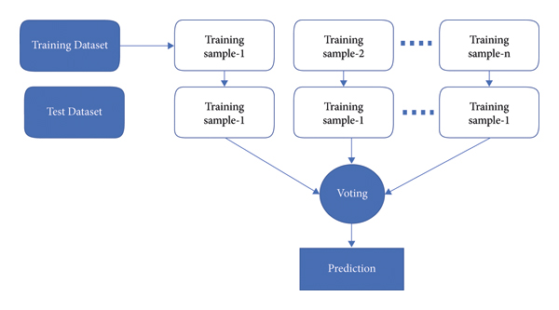
EXISTING SYSTEM
We have collected a entries and prepared a dataset
Cleaned and prepared the data for using in WEKA
We have trained four different models
Naive Bayes
J48
k-NN
Random Forest

Slide 5
PROPOSED SYSTEM
used Artificial Neural Networks (ANN), Support Vector Machine (SVM), Decision Tree, Logistic Regression, and ensemble methods (Bagging and Boosting) to classify the stroke disease.

Slide 6
DISADVANTAGES OF EXISTING SYSTEM
1. Limited Data Availability
2. Difficulty in Interpretation
3. Bias in Data
4. Overfitting
5. Lack of Transparency
ADVANTAGES OF PROPOSED SYSTEM
1. Accuracy
2. Cost-Effective
3. Increased Efficiency
4. Improved Patient Outcomes

Slide 7
SYSTEM REQUIRMENTS
HARDWARE REQUIRMENTS
• System : i3 or above.
• Ram : 4 GB.
• Hard Disk : 40 GB
SOFTWARE REQUIRMENTS
• Operating system : Windows 8 or Above(Anaconda – Spyder)
• Coding Language : python 3.5

Slide 8
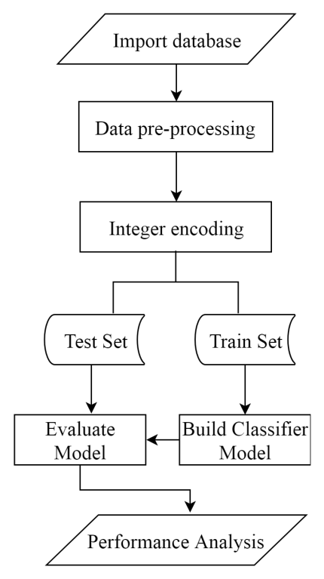
ARCHITECTURE

Slide 9
MODULES
1. Upload Stroke Dataset:
2. Dataset Preprocessing & Features Selection:
3. Train Naive Bayes Algorithm
4. Train J48 Algorithm:
5. Train KNN Algorithm:
6. Train Random Forest Algorithm:
7. Train ANN Algorithm
8. Comparison Graph:

Slide 10
UML DIAGRAMS
The Unified Modeling Language is a popular dialect for indicating, Visualization, Constructing and archiving the curios of programming framework, and for business demonstrating and different non-programming frameworks.
The UML speaks to an accumulation of first-rate building practices which have verified fruitful in the showing of full-size and complicated frameworks.
The UML is a essential piece of creating gadgets located programming and the product development method.
The UML makes use of commonly graphical documentations to specific the plan of programming ventures

Slide 11
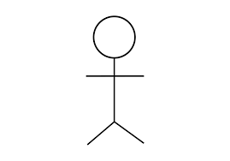
USE CASE DIAGRAM

Slide 12
CLASS DIAGRAM

Slide 13
SEQUENCE DIAGRAM

Slide 14
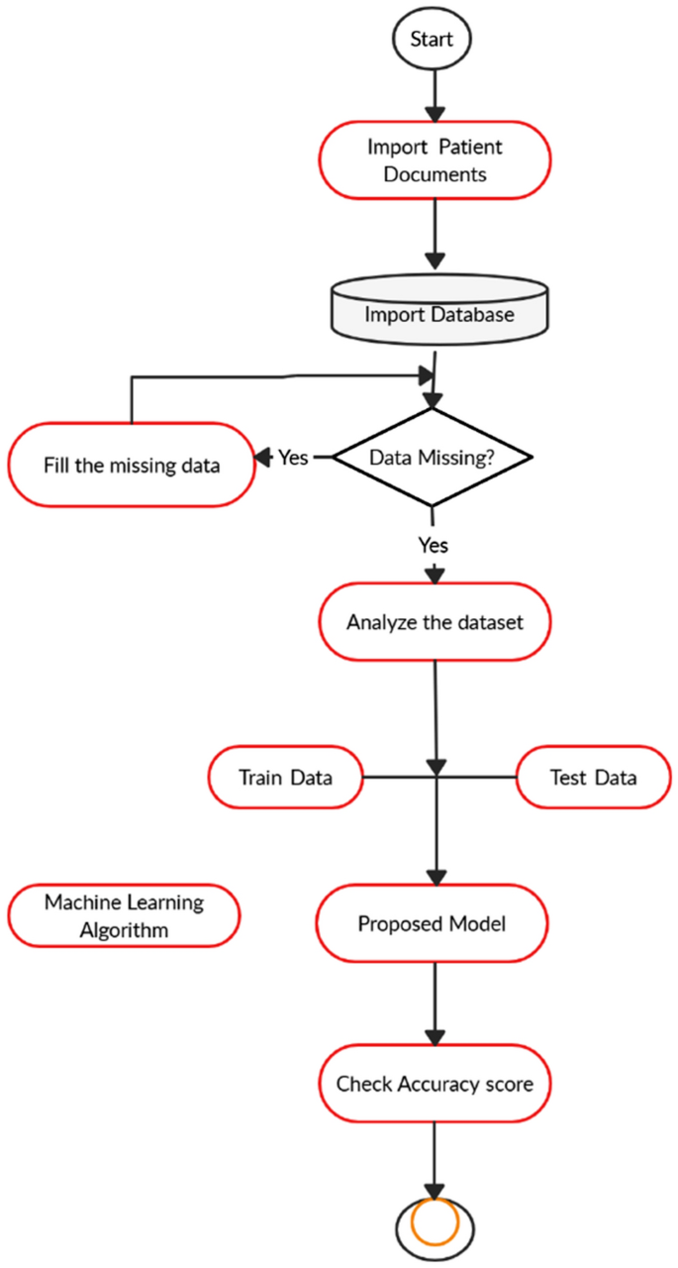
ACTIVITY DIAGRAM

Slide 15
SAMPLE CODE
from tkinter import *
import tkinter
from tkinter import filedialog
import numpy as np
from tkinter.filedialog import askopenfilename
from tkinter import simpledialog
import matplotlib.pyplot as plt
import os
import numpy as np
import pandas as pd
from sklearn.preprocessing import LabelEncoder
from sklearn.model_selection import train_test_split
from sklearn.ensemble import RandomForestClassifier
from sklearn.metrics import accuracy_score
from sklearn.metrics import precision_score
from sklearn.metrics import recall_score
from sklearn.metrics import f1_score

Slide 16
import seaborn as sns
from sklearn.metrics import confusion_matrix
from sklearn.naive_bayes import GaussianNB
from sklearn.tree import DecisionTreeClassifier
from sklearn.neighbors import KNeighborsClassifier
from keras.utils.np_utils import to_categorical
from keras.models import Sequential
from keras.layers import Dense, Dropout, Activation
main = tkinter.Tk()
main.title("Detection of Stroke Disease using Machine Learning Algorithms")
main.geometry("1000x650")
global filename, le1,le2,le3,le4,le5, dataset, rf
global X, Y
global X_train, X_test, y_train, y_test
accuracy = []
precision = []
recall = []
fscore = []

Slide 17
def loadDataset():
global filename, dataset
text.delete('1.0', END)
filename = filedialog.askopenfilename(initialdir="Dataset")
text.insert(END,str(filename)+" loaded\n\n")
dataset = pd.read_csv(filename)
text.insert(END,str(dataset.head()))
def preprocessDataset():
text.delete('1.0', END)
global X, Y
global X_train, X_test, y_train, y_test
global dataset, le1,le2,le3,le4,le5
le1 = LabelEncoder()
le2 = LabelEncoder()
le3 = LabelEncoder()
le4 = LabelEncoder()
le5 = LabelEncoder()
dataset.fillna(0, inplace = True)
dataset['gender'] = pd.Series(le1.fit_transform(dataset['gender'].astype(str)))
dataset['ever_married'] = pd.Series(le2.fit_transform(dataset['ever_married'].astype(str)))

Slide 18
dataset['work_type'] = pd.Series(le3.fit_transform(dataset['work_type'].astype(str)))
dataset['Residence_type'] = pd.Series(le4.fit_transform(dataset['Residence_type'].astype(str)))
dataset['smoking_status'] = pd.Series(le5.fit_transform(dataset['smoking_status'].astype(str)))
text.insert(END,str(dataset.head())+"\n\n")
text.update_idletasks()
label = dataset.groupby('stroke').size()
dataset = dataset.values
text.insert(END,"\nTotal attributes before applying features selection: "+str(dataset.shape[1])+"\n\n")
X = dataset[:,1:dataset.shape[1]-1]
Y = dataset[:,dataset.shape[1]-1]
indices = np.arange(X.shape[0])
np.random.shuffle(indices)
X = X[indices]
Y = Y[indices]
text.insert(END,"\nTotal attributes after applying features selection: "+str(X.shape[1])+"\n\n")
X_train, X_test, y_train, y_test = train_test_split(X, Y, test_size=0.2)
text.insert(END,"Total records found in dataset : "+str(X.shape[0])+"\n\n")

Slide 19
text.insert(END,"Dataset split for train and test. 80% for training and 20% for testing\n\n")
text.insert(END,"Total records used to train Machine Learning Algorithms : "+str(X_train.shape[0])+"\n")
text.insert(END,"Total records used to test Machine Learning Algorithms : "+str(X_test.shape[0])+"\n")
label.plot(kind="bar")
plt.title("Number of Normal & Stroke Disease Instances in dataset")
plt.show()
def calculateMetrics(predict, testY, algorithm):
p = precision_score(testY, predict,average='macro') * 100
r = recall_score(testY, predict,average='macro') * 100
f = f1_score(testY, predict,average='macro') * 100
a = accuracy_score(testY,predict)*100
text.insert(END,algorithm+' Accuracy : '+str(a)+"\n")
text.insert(END,algorithm+' Precision : '+str(p)+"\n")
text.insert(END,algorithm+' Recall : '+str(r)+"\n")
text.insert(END,algorithm+' FScore : '+str(f)+"\n\n")
accuracy.append(a)
precision.append(p)
recall.append(r)
fscore.append(f)

Slide 20
text.update_idletasks()
LABELS = ['Normal','Stroke']
conf_matrix = confusion_matrix(testY, predict)
plt.figure(figsize =(6, 6))
ax = sns.heatmap(conf_matrix, xticklabels = LABELS, yticklabels = LABELS, annot = True, cmap="viridis" ,fmt ="g");
ax.set_ylim([0,2])
plt.title(algorithm+" Confusion matrix")
plt.ylabel('True class')
plt.xlabel('Predicted class')
plt.show()
def trainNaiveBayes():
global X_train, X_test, y_train, y_test
text.delete('1.0', END)
cls = GaussianNB()
cls.fit(X_train, y_train)
predict = cls.predict(X_test)
calculateMetrics(predict, y_test, "Naive Bayes")

Slide 21
def trainDT():
global X_train, X_test, y_train, y_test
cls = DecisionTreeClassifier()
cls.fit(X_train, y_train)
predict = cls.predict(X_test)
calculateMetrics(predict, y_test, "J48 Algorithm")
def trainKNN():
global X_train, X_test, y_train, y_test
cls = KNeighborsClassifier(n_neighbors = 2)
cls.fit(X_train, y_train)
predict = cls.predict(X_test)
calculateMetrics(predict, y_test, "KNN")
def trainRanfomForest():
global X_train, X_test, y_train, y_test, rf
cls = RandomForestClassifier()
cls.fit(X_train, y_train)
rf = cls
predict = cls.predict(X_test)
calculateMetrics(predict, y_test, "Random Forest")

Slide 22
def graph():
df = pd.DataFrame([['Naive Bayes','Precision',precision[0]],['Naive Bayes','Recall',recall[0]],['Naive Bayes','F1 Score',fscore[0]],['Naive Bayes','Accuracy',accuracy[0]],
['J48','Precision',precision[1]],['J48','Recall',recall[1]],['J48','F1 Score',fscore[1]],['J48','Accuracy',accuracy[1]],
['KNN','Precision',precision[2]],['KNN','Recall',recall[2]],['KNN','F1 Score',fscore[2]],['KNN','Accuracy',accuracy[2]],
['Random Forest','Precision',precision[3]],['Random Forest','Recall',recall[3]],['Random Forest','F1 Score',fscore[3]],['Random Forest','Accuracy',accuracy[3]],
['ANN','Precision',precision[4]],['ANN','Recall',recall[4]],['ANN','F1 Score',fscore[4]],['ANN','Accuracy',accuracy[4]],
],columns=['Parameters','Algorithms','Value'])
df.pivot("Parameters", "Algorithms", "Value").plot(kind='bar')
plt.show()

Slide 23
def trainANN():
global X, Y
Y1 = to_categorical(Y)
X_train1, X_test1, y_train1, y_test1 = train_test_split(X, Y1, test_size=0.2)
ann_model = Sequential()
ann_model.add(Dense(512, input_shape=(X_train1.shape[1],)))
ann_model.add(Activation('relu'))
ann_model.add(Dropout(0.3))
ann_model.add(Dense(512))
ann_model.add(Activation('relu'))
ann_model.add(Dropout(0.3))
ann_model.add(Dense(2))
ann_model.add(Activation('softmax'))
ann_model.compile(loss='categorical_crossentropy', optimizer='adam', metrics=['accuracy'])
print(ann_model.summary())
acc_history = ann_model.fit(X, Y1, epochs=200, validation_data=(X_test1, y_test1))
print(ann_model.summary())
predict = ann_model.predict(X_test1)
predict = np.argmax(predict, axis=1)
testY = np.argmax(y_test1, axis=1)
calculateMetrics(predict, testY, "ANN")

Slide 24
def predict():
text.delete('1.0', END)
global rf, le1,le2,le3,le4,le5
testfile = filedialog.askopenfilename(initialdir="Dataset")
dataset = pd.read_csv(testfile)
dataset.fillna(0, inplace = True)
dataset['gender'] = pd.Series(le1.transform(dataset['gender'].astype(str)))
dataset['ever_married'] = pd.Series(le2.transform(dataset['ever_married'].astype(str)))
dataset['work_type'] = pd.Series(le3.transform(dataset['work_type'].astype(str)))
dataset['Residence_type'] = pd.Series(le4.transform(dataset['Residence_type'].astype(str)))
dataset['smoking_status'] = pd.Series(le5.transform(dataset['smoking_status'].astype(str)))
dataset = dataset.values
dataset = dataset[:,1:dataset.shape[1]]
predict = rf.predict(dataset)
print(predict)
for i in range(len(predict)):
if predict[i] == 0:
text.insert(END,"Test Data = "+str(dataset[i])+" PREDICTED AS ====> NO STROKE\n\n")
if predict[i] == 1:

Slide 25
if predict[i] == 1:
text.insert(END,"Test Data = "+str(dataset[i])+" PREDICTED AS ====> STROKE\n\n")
font = ('times', 15, 'bold')
title = Label(main, text='Detection of Stroke Disease using Machine Learning Algorithms', justify=LEFT)
title.config(bg='lavender blush', fg='DarkOrchid1')
title.config(font=font)
title.config(height=3, width=120)
title.place(x=100,y=5)
title.pack()
font1 = ('times', 12, 'bold')
loadButton = Button(main, text="Upload Stroke Dataset", command=loadDataset)
loadButton.place(x=10,y=100)
loadButton.config(font=font1)
preprocessButton = Button(main, text="Dataset Preprocessing & Features Selection", command=preprocessDataset)
preprocessButton.place(x=300,y=100)
preprocessButton.config(font=font1)

Slide 26
nbButton = Button(main, text="Train Naive Bayes Algorithm", command=trainNaiveBayes)
nbButton.place(x=730,y=100)
nbButton.config(font=font1)
dtButton = Button(main, text="Train J48 Algorithm", command=trainDT)
dtButton.place(x=10,y=150)
dtButton.config(font=font1)
knnButton = Button(main, text="Train KNN Algorithm", command=trainKNN)
knnButton.place(x=300,y=150)
knnButton.config(font=font1)
rfButton = Button(main, text="Train Random Forest Algorithm", command=trainRanfomForest)
rfButton.place(x=730,y=150)
rfButton.config(font=font1)
annButton = Button(main, text="Train ANN Algorithm", command=trainANN)
annButton.place(x=10,y=200)
annButton.config(font=font1)
graphButton = Button(main, text="Comparison Graph", command=graph)
graphButton.place(x=300,y=200)
graphButton.config(font=font1)

Slide 27
predictButton = Button(main, text="Predict Disease on Test Data", command=predict)
predictButton.place(x=730,y=200)
predictButton.config(font=font1)
font1 = ('times', 12, 'bold')
text=Text(main,height=20,width=160)
scroll=Scrollbar(text)
text.configure(yscrollcommand=scroll.set)
text.place(x=10,y=250)
text.config(font=font1)
main.config(bg='light coral')
main.mainloop()

Slide 28
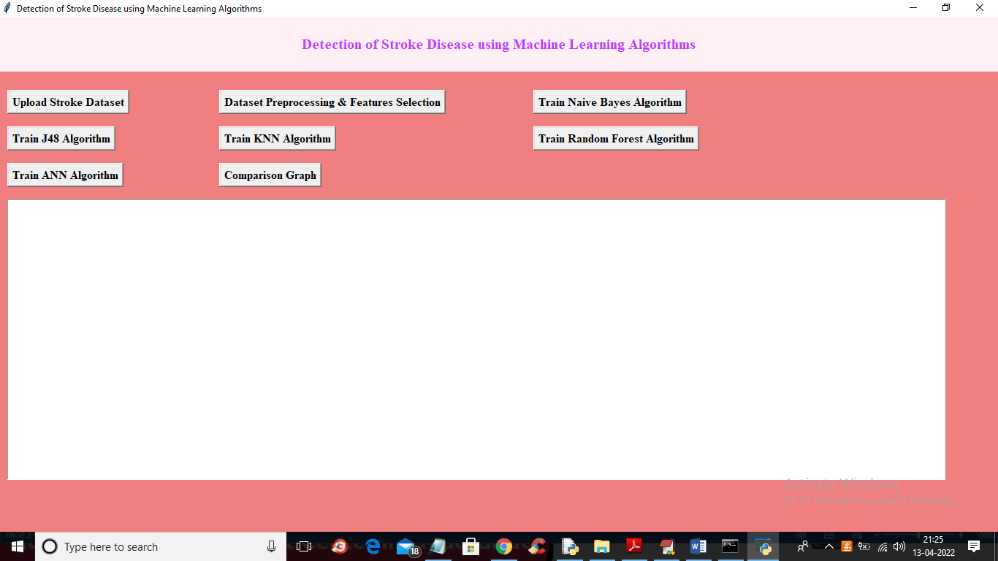
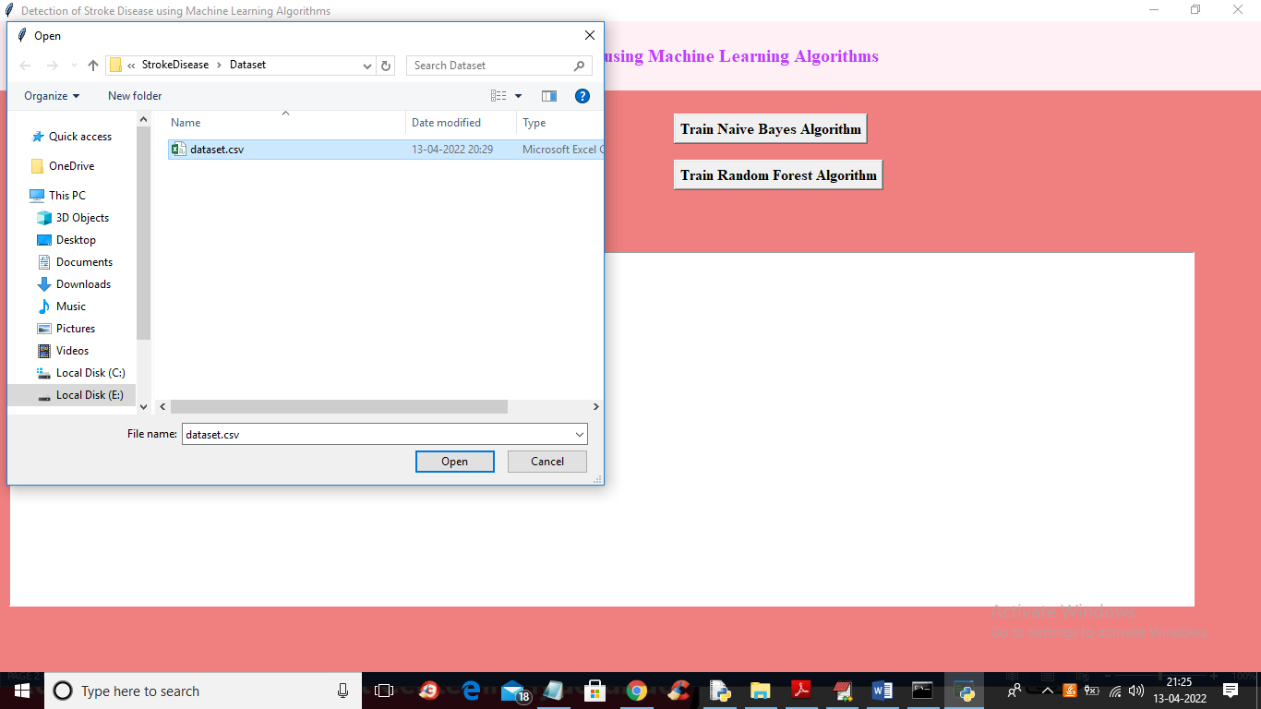
RESULTS

Slide 29
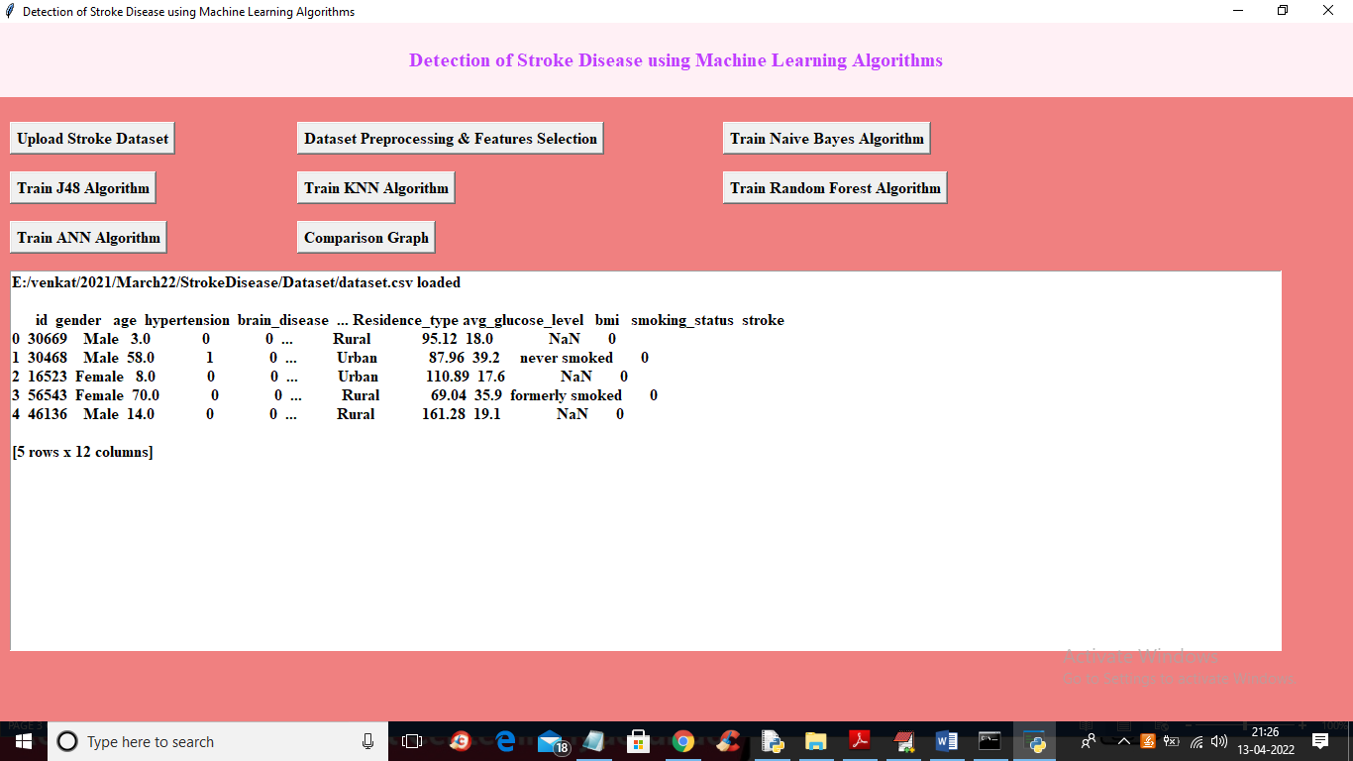
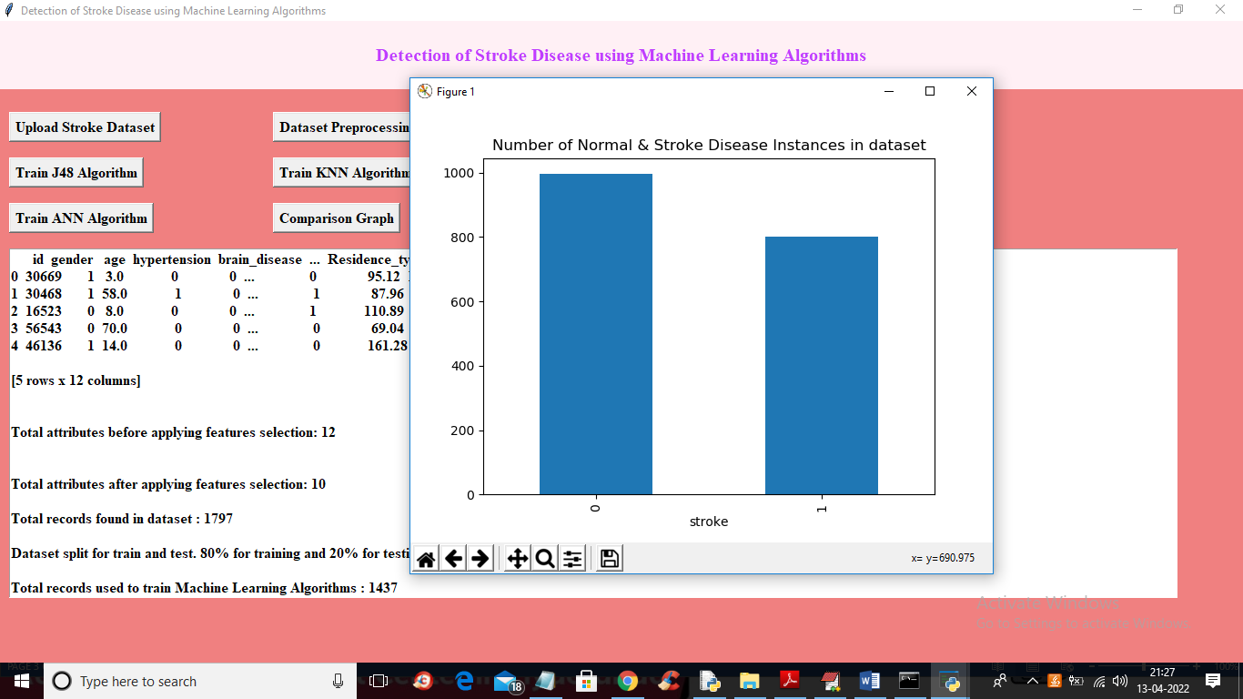

Slide 30
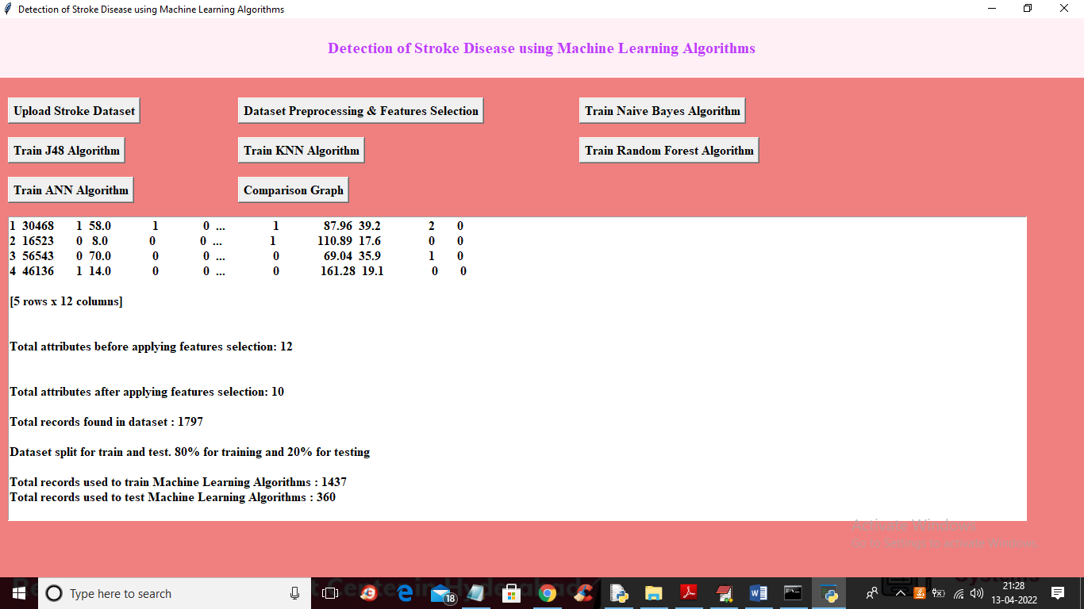
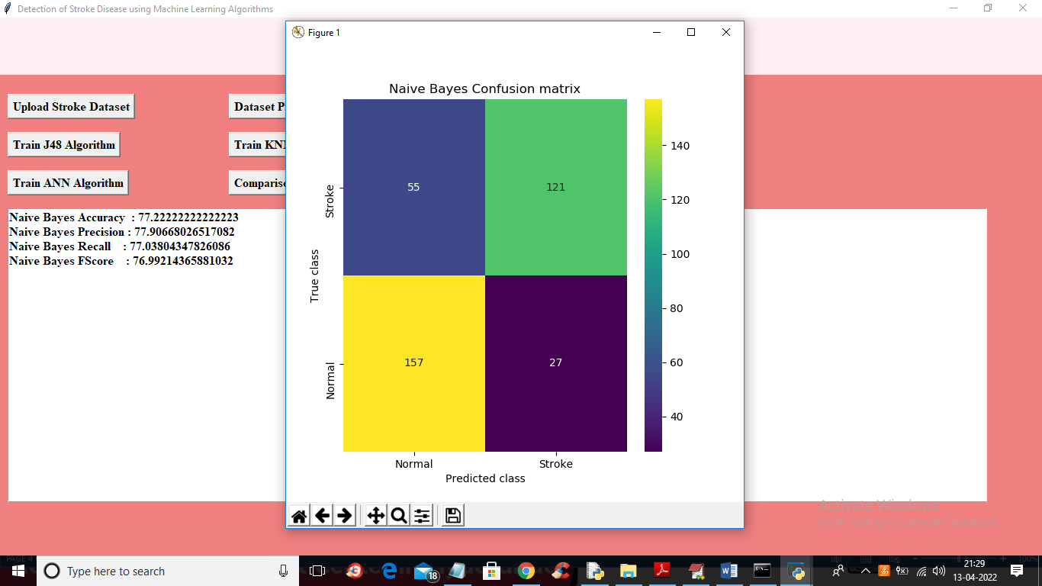

Slide 31
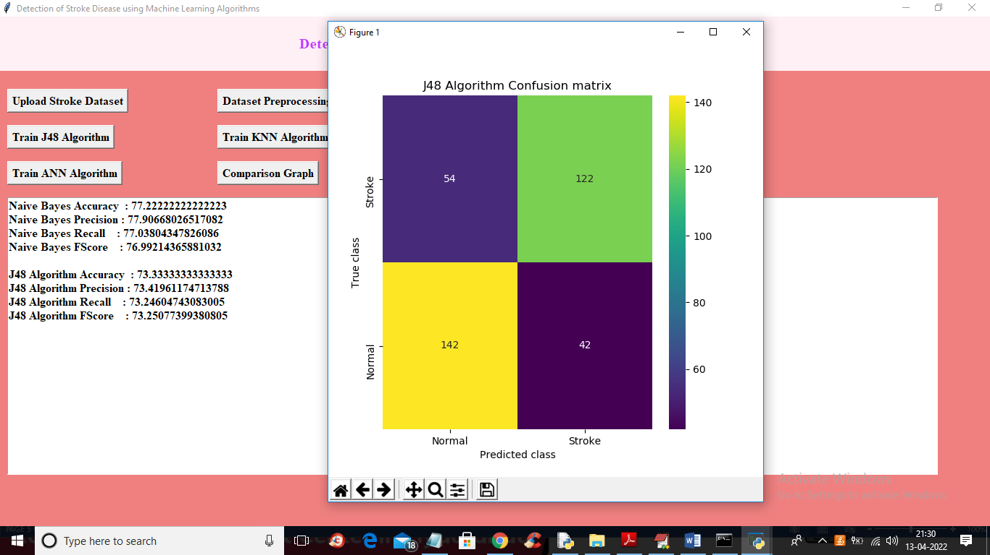
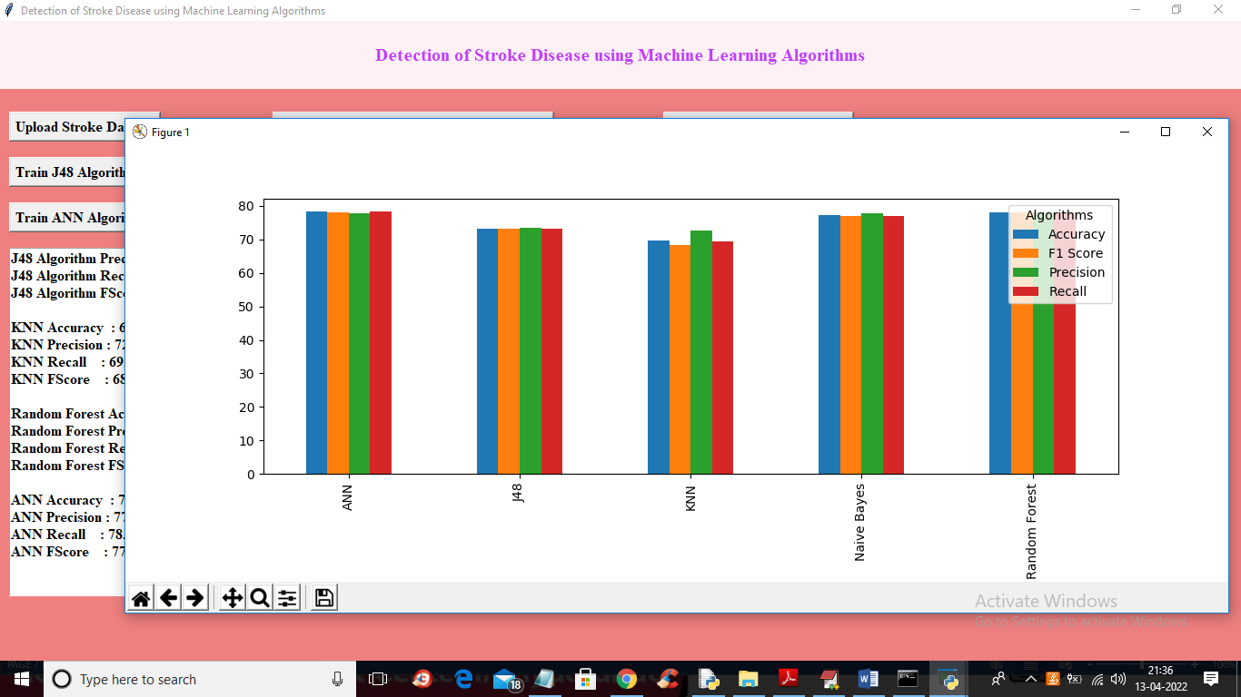

Slide 32
CONCLUSION
The use of machine learning algorithms for the detection of stroke disease has shown promising results in recent studies. These algorithms are able to analyze large amounts of data, including patient medical histories, imaging tests, and other relevant factors, to accurately identify individuals who may be at risk of developing a stroke.

Slide 33
REFERENCES
[1] S. H. Pahus, A. T. Hansen, and A.-M. Hvas, “Thrombophilia testing in young patients with ischemic stroke,” Thrombosis research, vol. 137, pp. 108–112, 2016.
[2] P. Govindarajan, R. K. Soundarapandian, A. H. Gandomi, R. Patan, P. Jayaraman, and R. Manikandan, “Classification of stroke disease using machine learning algorithms,” Neural Computing and Applications, pp. 1–12.
[3] L. T. Kohn, J. Corrigan, M. S. Donaldson, et al., To err is human: building a safer health system, vol. 6. National academy press Washington, DC, 2000.
[4] R. Jeena and S. Kumar, “Stroke prediction using svm,” in 2016 International Conference on Control, Instrumentation, Communication and Computational Technologies (ICCICCT), pp. 600–602, IEEE, 2016.
[5] P. A. Sandercock, M. Niewada, and A. Członkowska, “The international stroke trial database,” Trials, vol. 13, no. 1, pp. 1–1, 2012.

Slide 34
THANK YOU

